Slide 1
19CSE 202 DBMS FINAL REVIEW CAR RENTAL SYSTEM
Team Members:
S.NO | REG.NO | NAME | ROLE
1 | CB.EN.U4CSE1905 | A SATYA HEMANTH | TESTING AND DOCUMENTING
2 | CB.EN.U4CSE19449 | SAI KOUSHIK | DEVELOPER
3 | CB.EN.U4CSE19453 | ABHINAV RAVELLA | DESIGNER
4 | CB.EN.U4CSE19459 | SHANTHAN REDDY | LEADER

Slide 2
Problem definition
CAR RENTAL SYSTEM:
To design a website design to increase customer retention and to simplify vehicle and staff management.
The main objective of the website car Rental System requires a temporary vehicle, for example those who do not own their own car, or owners of damaged or destroyed vehicles who are awaiting repair or insurance compensation or travelers who are out of town.

Slide 3
Functionalities & Modules
Keeps track of different models vehicles in different locations.
A customer can check for all the availability of cars of his choice and book them.
Billing is done on returning of the car.
Certain caution deposit is taken before renting a car.
An admin can keep a track of all customers ,cars and car bookings.
We are proposing a WEBSITE DESIGN
End users:
Admin
Guest users
Registered users

Slide 4
Motivation
To design a website design to increase customer retention and to simplify vehicle and staff management. The main objective of the website car Rental System requires a temporary vehicle.
For example those who do not own their own car, or owners of damaged or destroyed vehicles who are awaiting repair or insurance compensation or travelers who are out of town.
NEED FOR ?
This system makes the customers work to search for cars easy as all the details about the availability of different cars are available. This system also helps the car rental company to find the customers easily.

Slide 5



Software/Tools Used
For Database : xampp, phpMyAdmin, MySql
For User Interface : HTML, CSS, JS, PHP

Slide 6
WHY USE PHP?
PHP is an acronym for "Hypertext Preprocessor".
It is a widely-used, open source scripting language especially for web development.
PHP can add, delete, modify data in your database.
PHP can send and receive cookies.
PHP can send and receive form data.

Slide 7
CONNECTION:
<?php
function OpenCon()
{
$dbhost = "localhost";
$dbuser = "root";
$dbpass = "****";
$db = "example";
$conn = new mysqli($dbhost, $dbuser, $dbpass,$db)
or
die("Connect failed: %s\n". $conn -> error);
return $conn;
}
function CloseCon($conn)
{
$conn -> close();
}

Slide 8
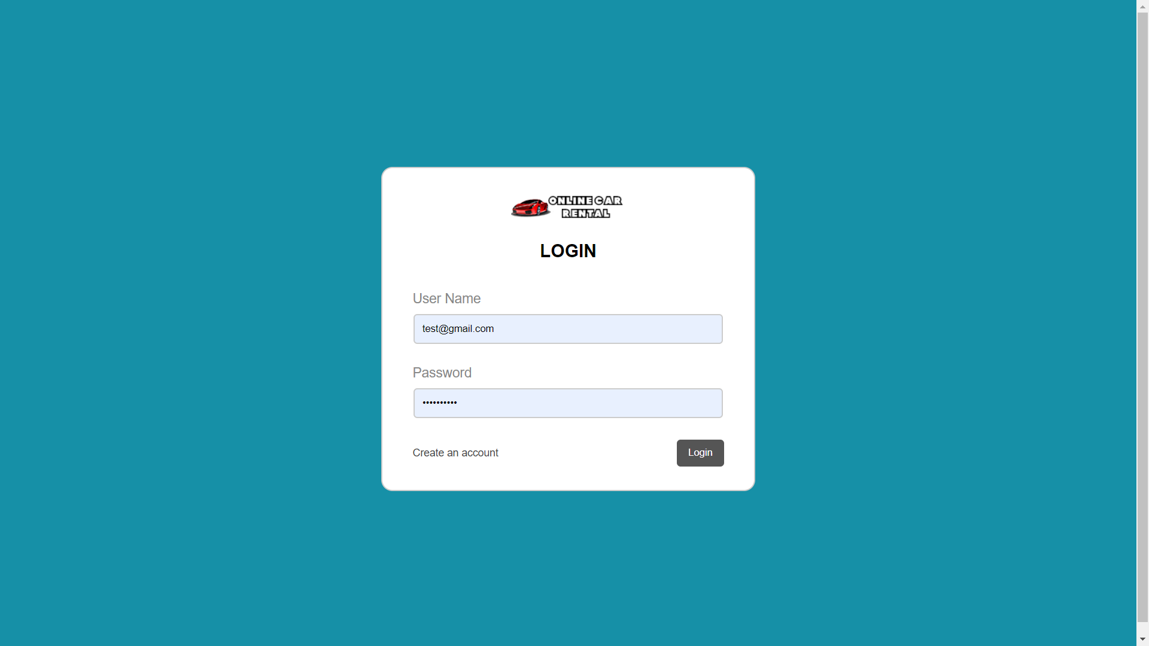
UI Screenshots

Slide 9
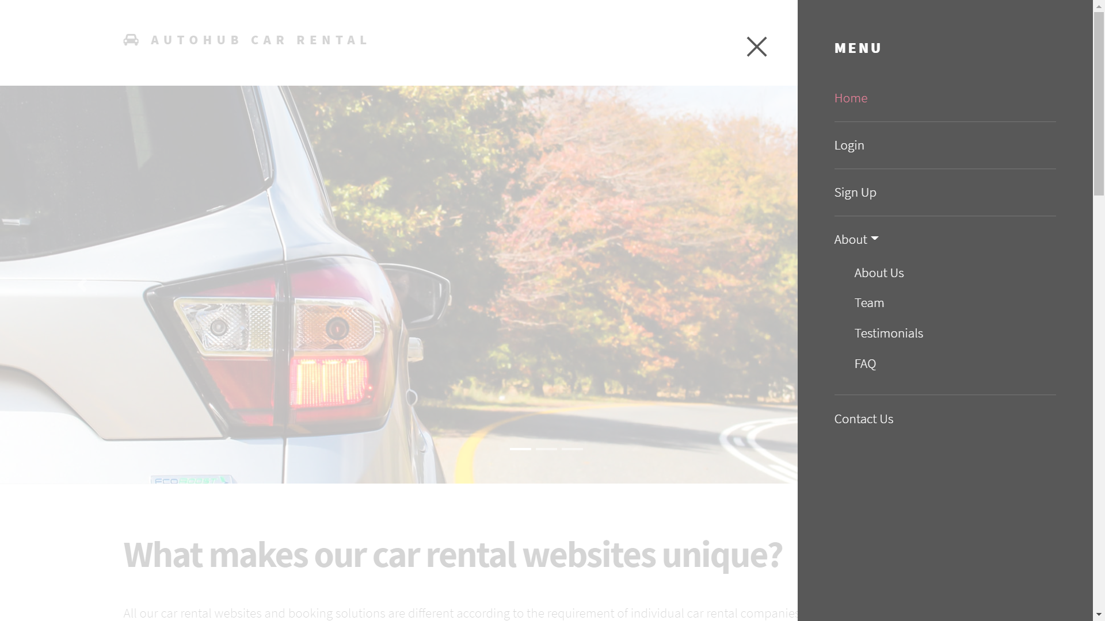
UI Screenshots

Slide 10
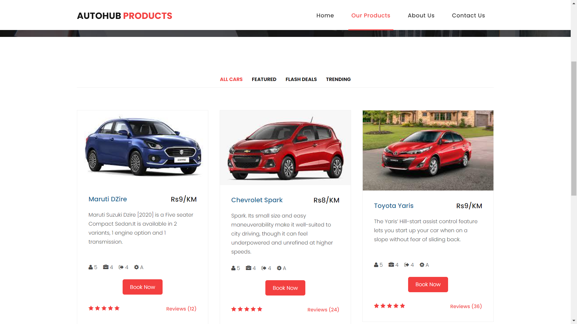
UI Screenshots

Slide 11
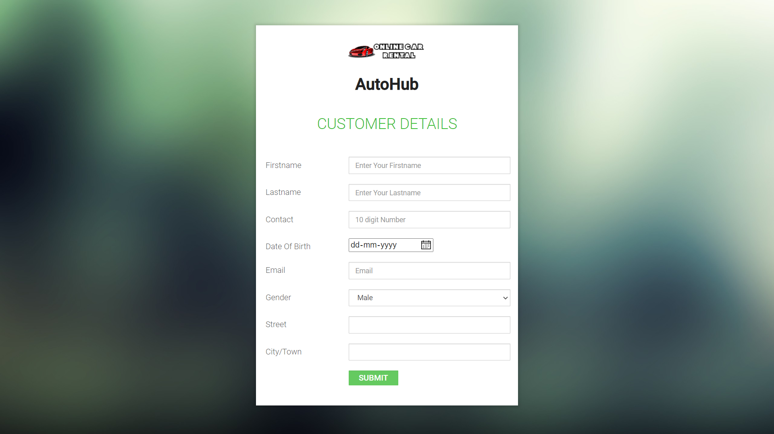
UI Screenshots

Slide 12
Demo
http://localhost/AutoHub/index.html

Slide 13
Conclusion
Our website Car rental system helps customers to easily search for cars and book them.In our website the customer is first expected to login to view the car information and all.
After log in only the customer can see the entire car details. If the customer does not have any account he can sign up and his data will be stored in our database.
After logging in the customer is expected to fill his personal details and that data will also be stored in the database.after that the customer can check and search for different cars.
After choosing the car the customer can book the car by pressing Book Now button.
After that the information will be stored in the database and the car will be booked.

Slide 14
References
https://www.w3schools.com/css/default.asp
https://www.javatpoint.com/phpmyadmin
https://www.cloudways.com/blog/connect-mysql-with-php/
https://www.apachefriends.org/index.html
https://www.php.net/downloads.php

Slide 15
THANK YOU

